Slide 1
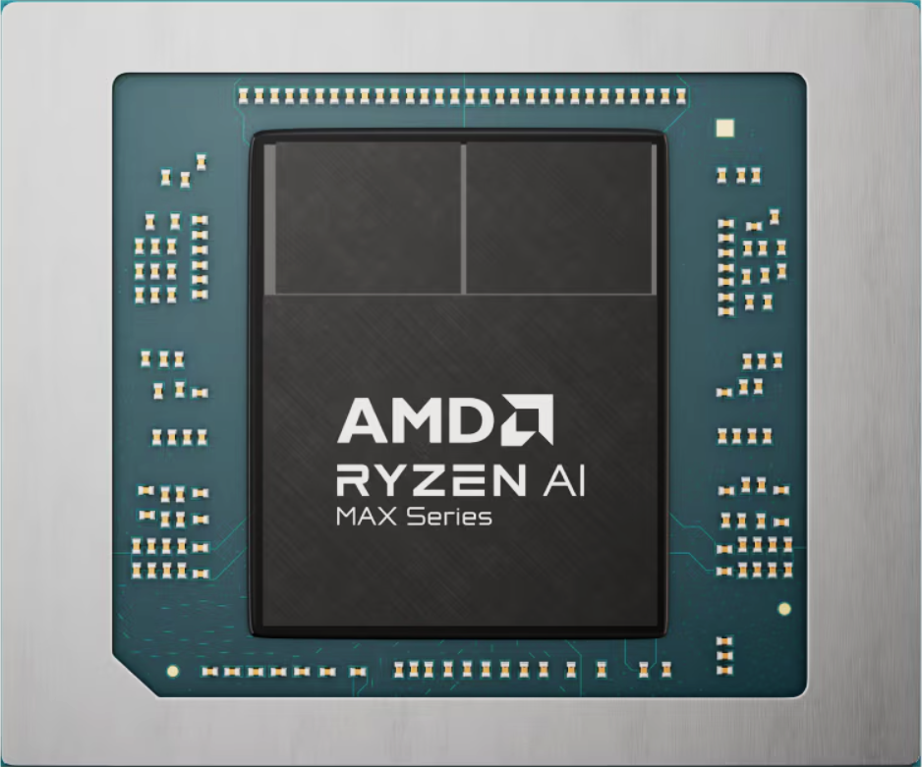
AMD Ryzen™ Al Max+ 395
Together we advance
Release on Jan 6th 2025
TSMC
N4P
Up to 5.1Ghz
55W
TDP
configurable
TDP (45-120W)
RDNA 3.5
“Zen5”
XDNA 2
Unified memory architecture
Up to 128GB LPDDR5x-8000
林偉翔01257174 許能翔01257176
2025年计算机结构期末报告

Slide 2
Overview
Overview

Slide 3
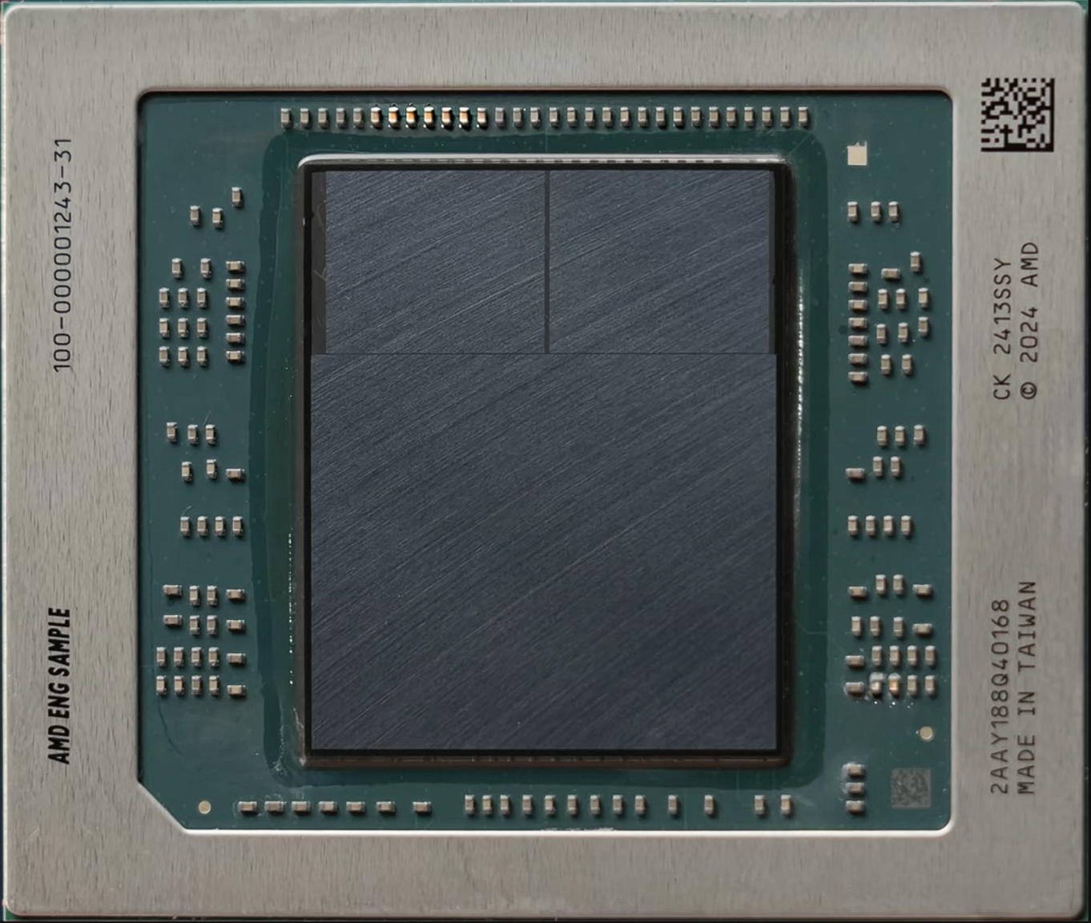

Slide 4
CCD #0
CCD #1
I/O Die

Slide 5
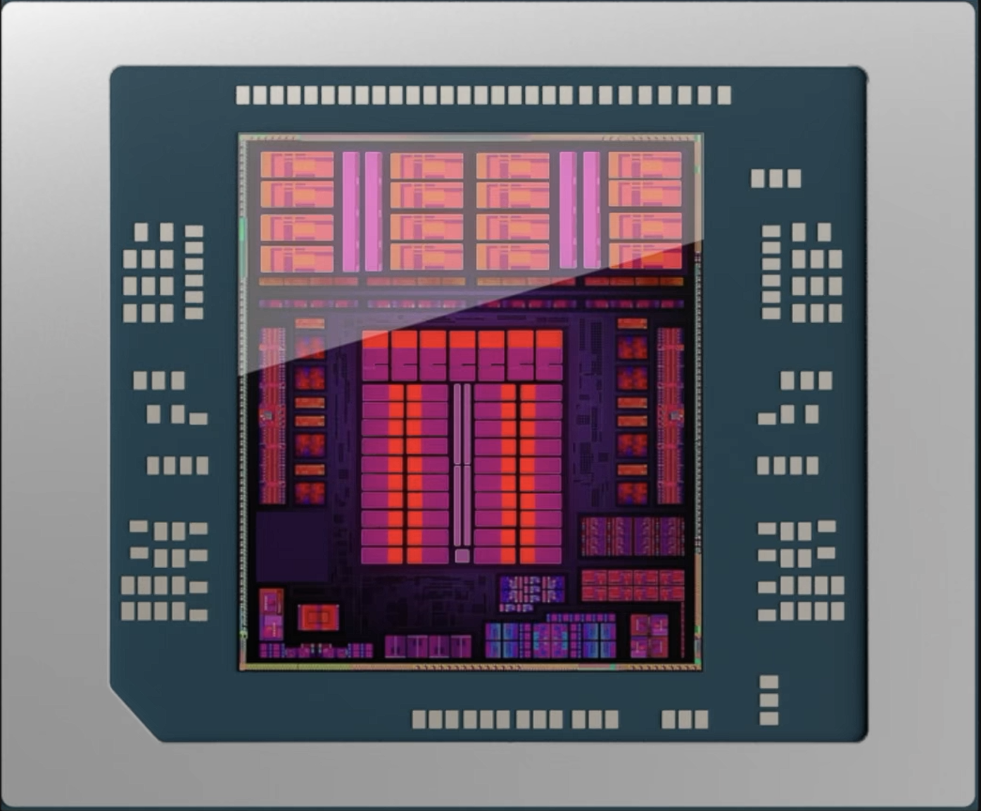
Ryzen Al Max+ 395

Slide 6
Ryzen Al Max+ 395
16-Core CPU (32 Threads)
“Zen5” CPU microarchitecture
40-CUs GPU
Improved branch prediction
“RDNA 3.5” GPU architecture
8-wide instruction decode
2x Texture Sampler Rate
40% larger reorder buffer
2x Interpolation and Comparison Rates
Hierarchy cache memory
Improved Memory Management
16 x 48 KB for L1D
16 x 32 KB for L1I
16 x 1024 KB for L2
2 x 32768 KB for L3

Slide 7
Ryzen Al Max+ 395
16-Core CPU (32 Threads)
“Zen5” CPU microarchitecture
40-CUs GPU
Improved branch prediction
“RDNA 3.5” GPU architecture
8-wide instruction decode
2x Texture Sampler Rate
40% larger reorder buffer
2x Interpolation and Comparison Rates
Hierarchy cache memory
Improved Memory Management
16 x 48 KB for L1D
16 x 32 KB for L1I
16 x 1024 KB for L2
Next-Gen NPU
2 x 32768 KB for L3
“XDNA 2” NPU architecture
5x compute capacity
2x power efficiency
50 TOPS (Overall 126 TOPS)

Slide 8
ZEN5
About ‘Zen5’

Slide 9
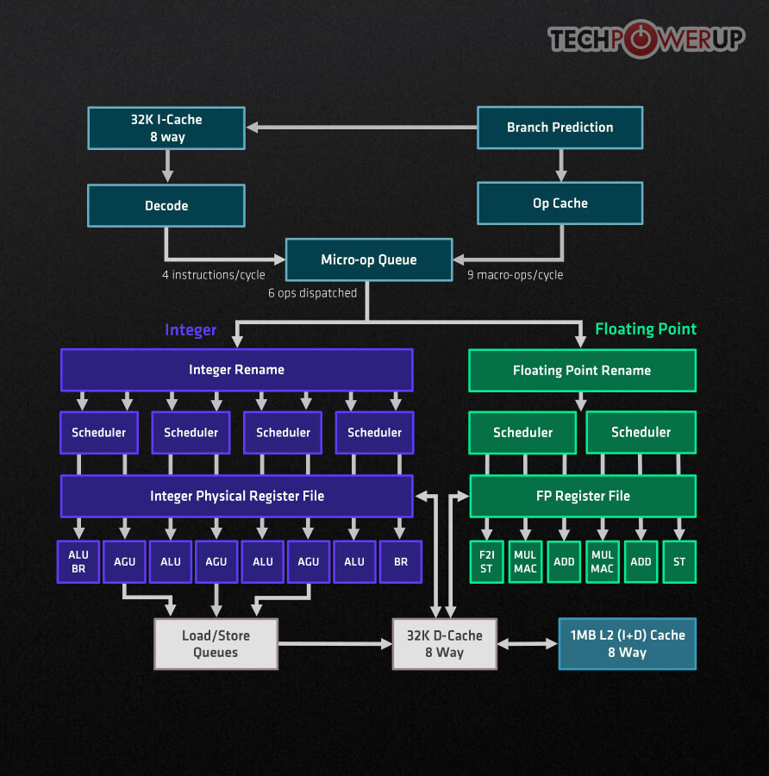
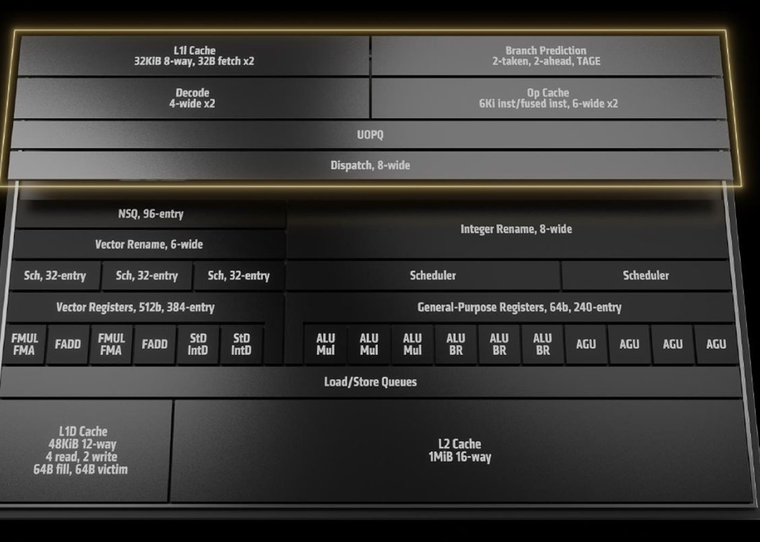

Slide 10
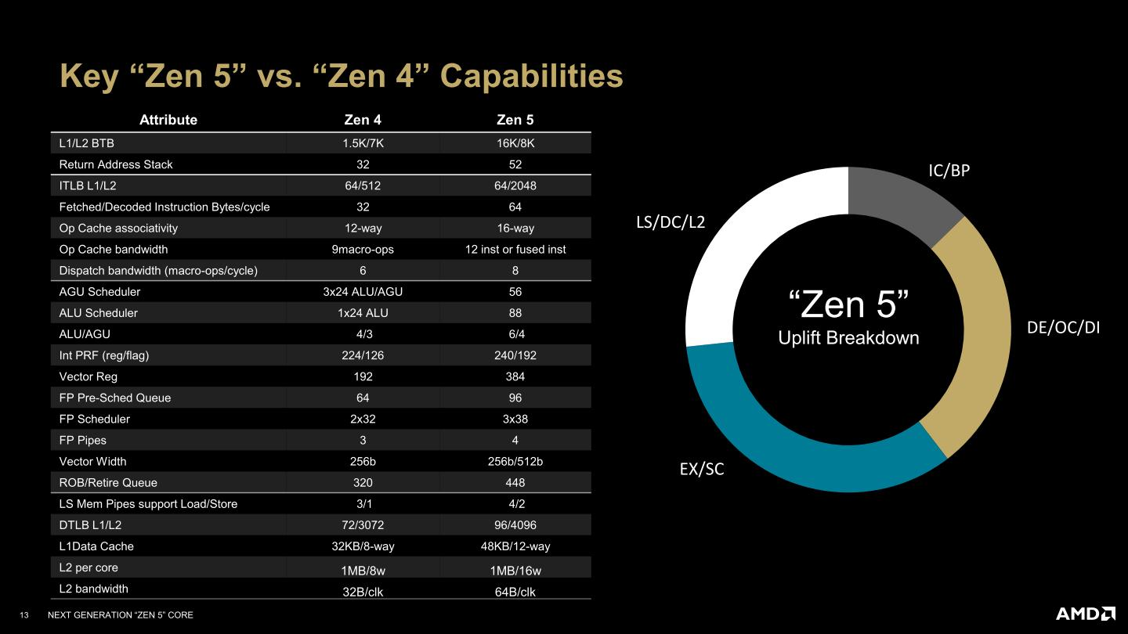

Slide 11
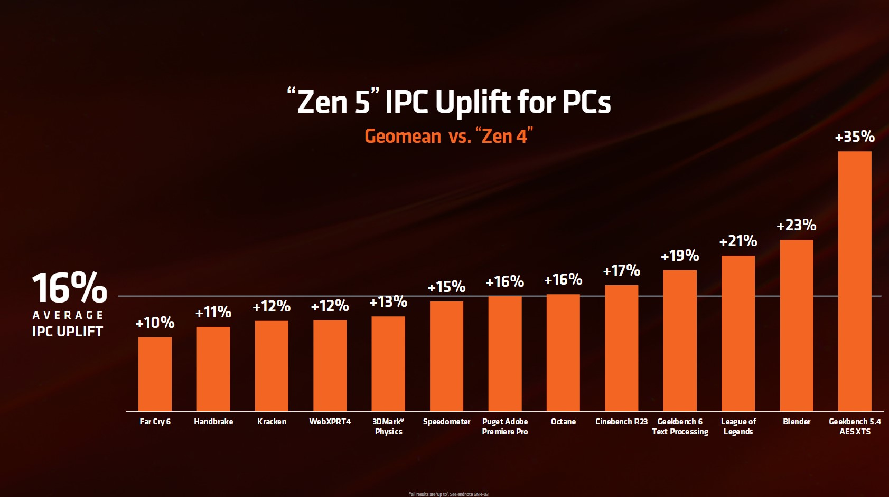

Slide 12
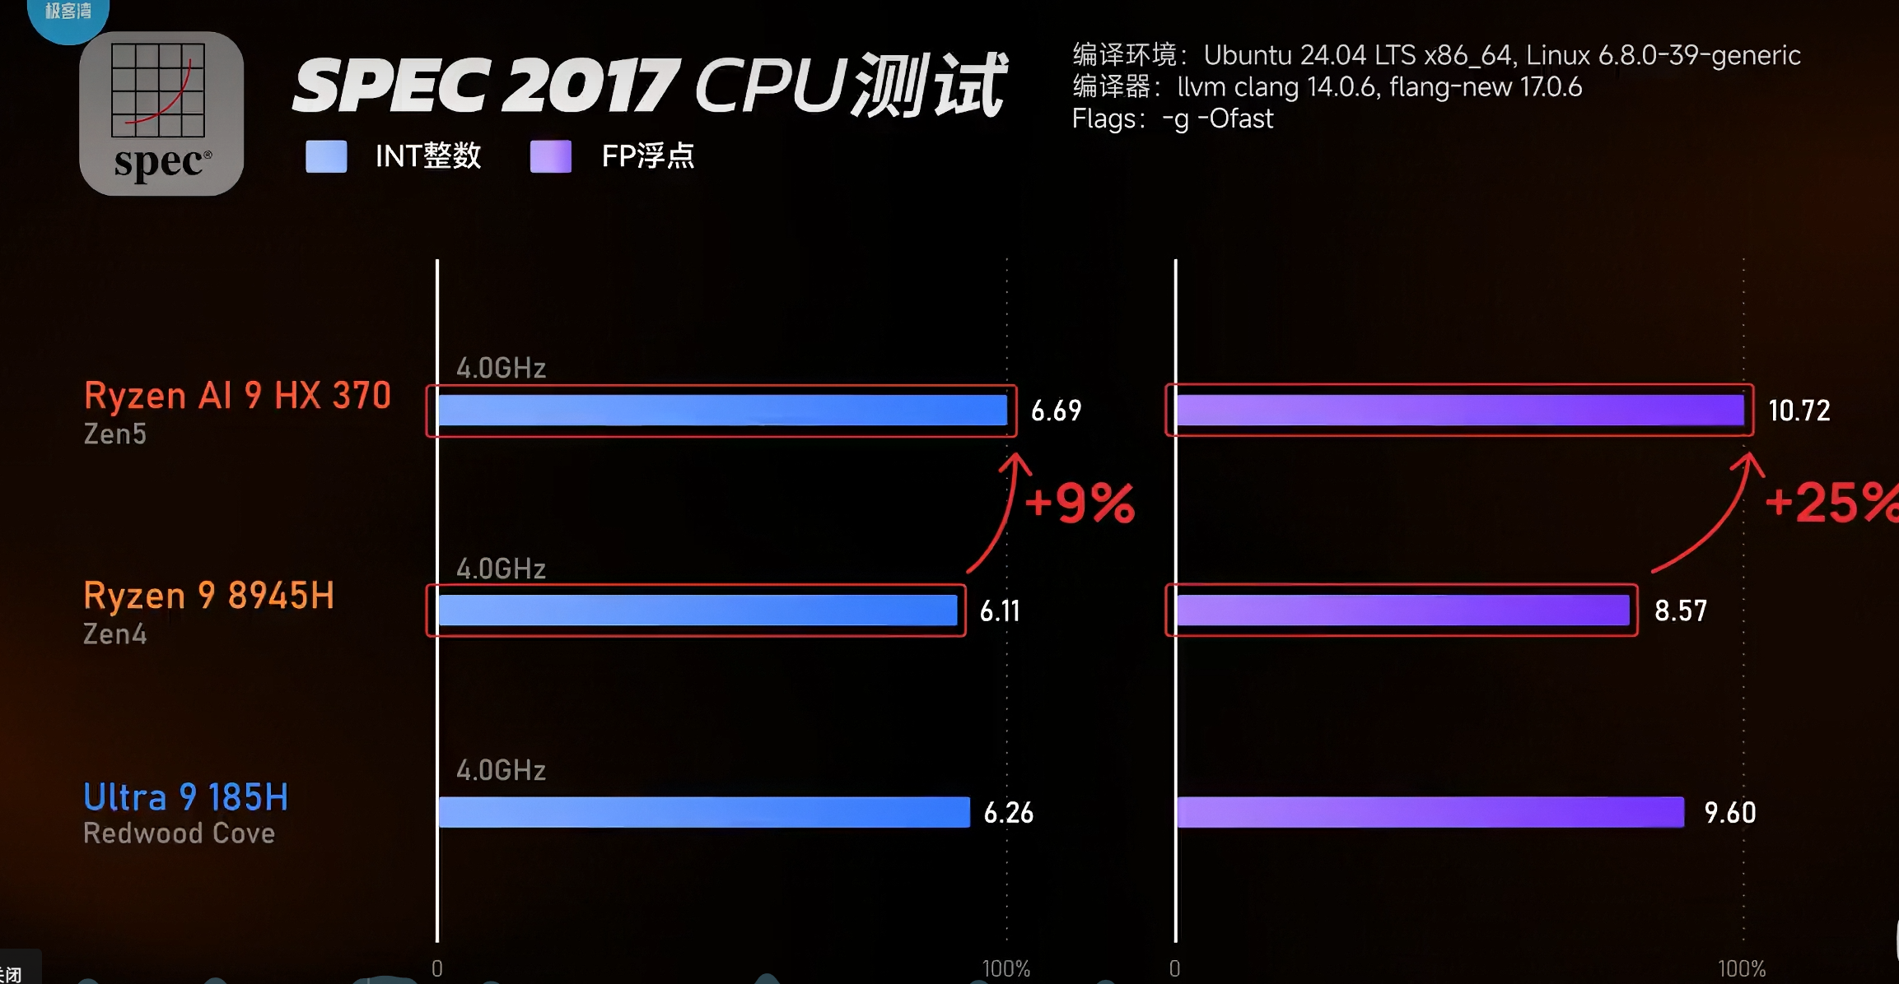

Slide 13
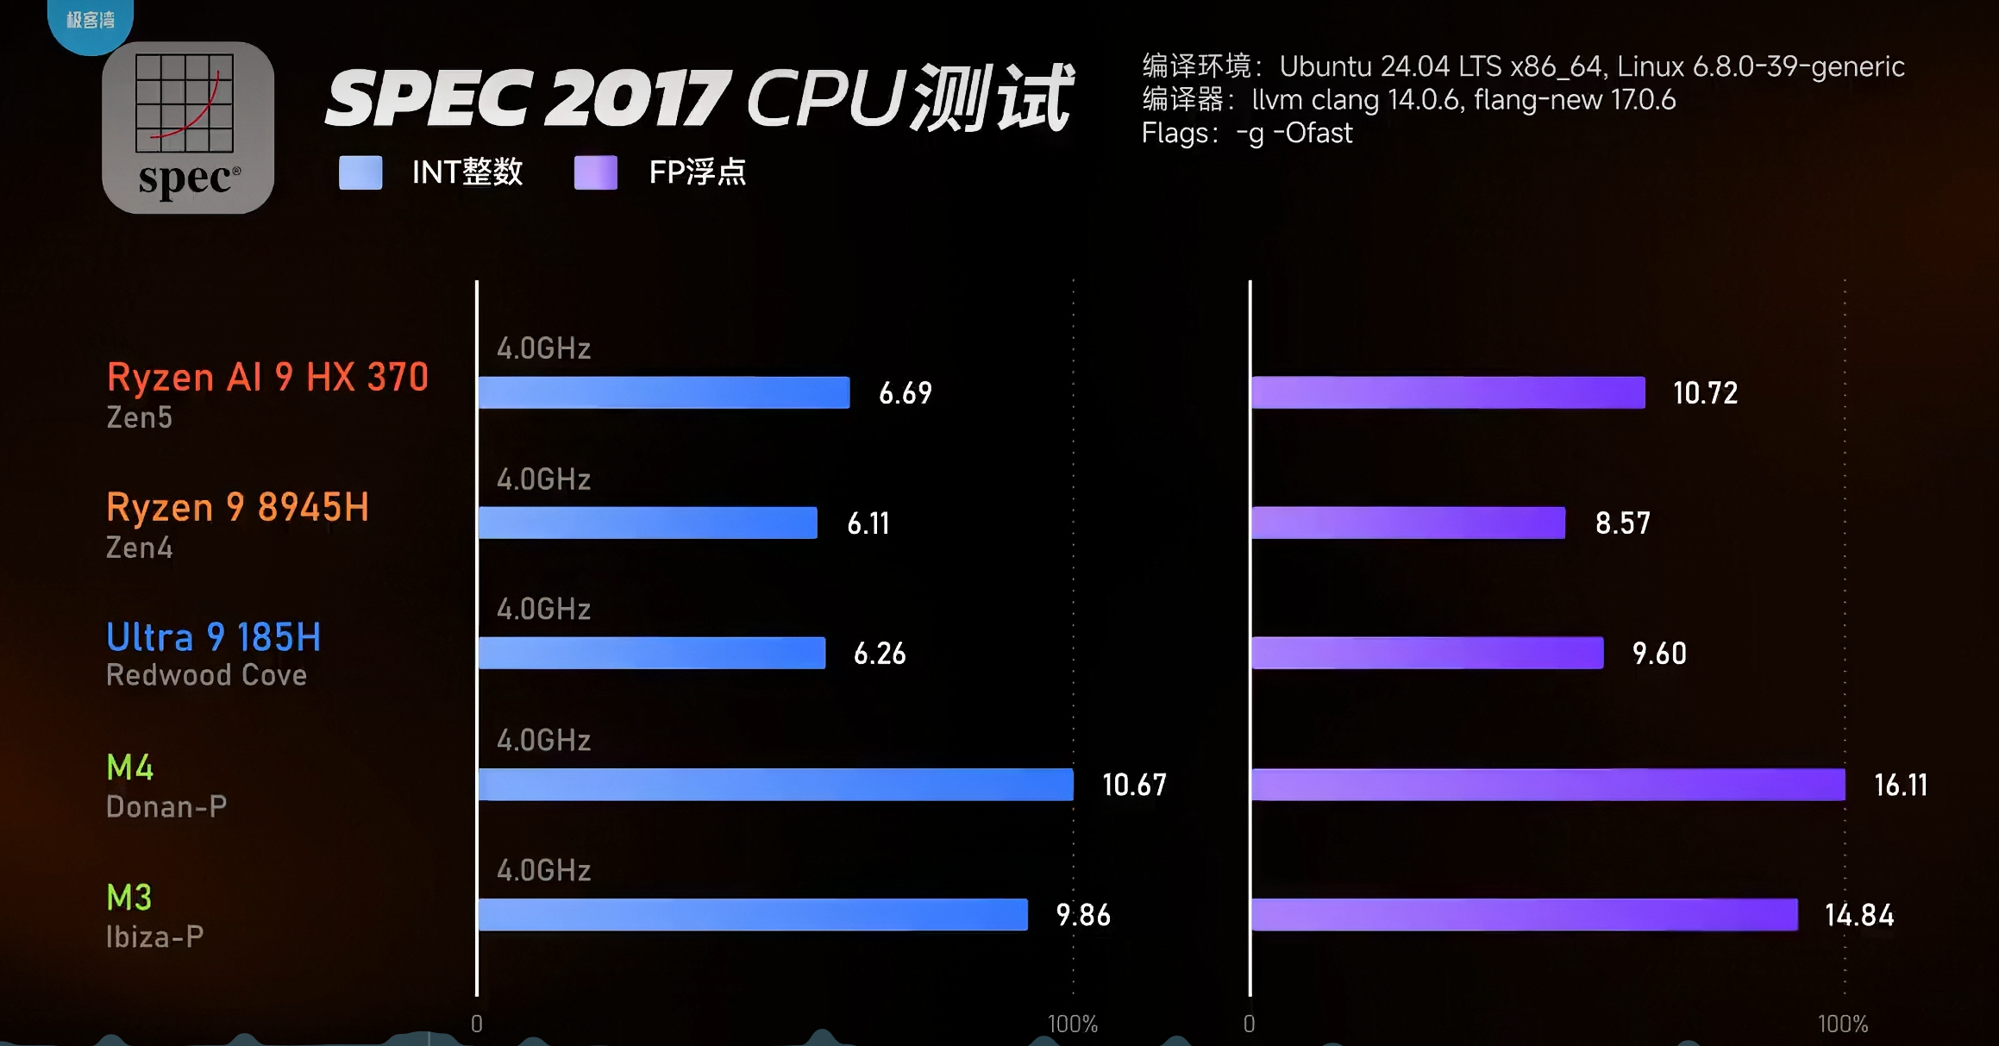

Slide 14
RDNA
RDNA 3.5

Slide 15
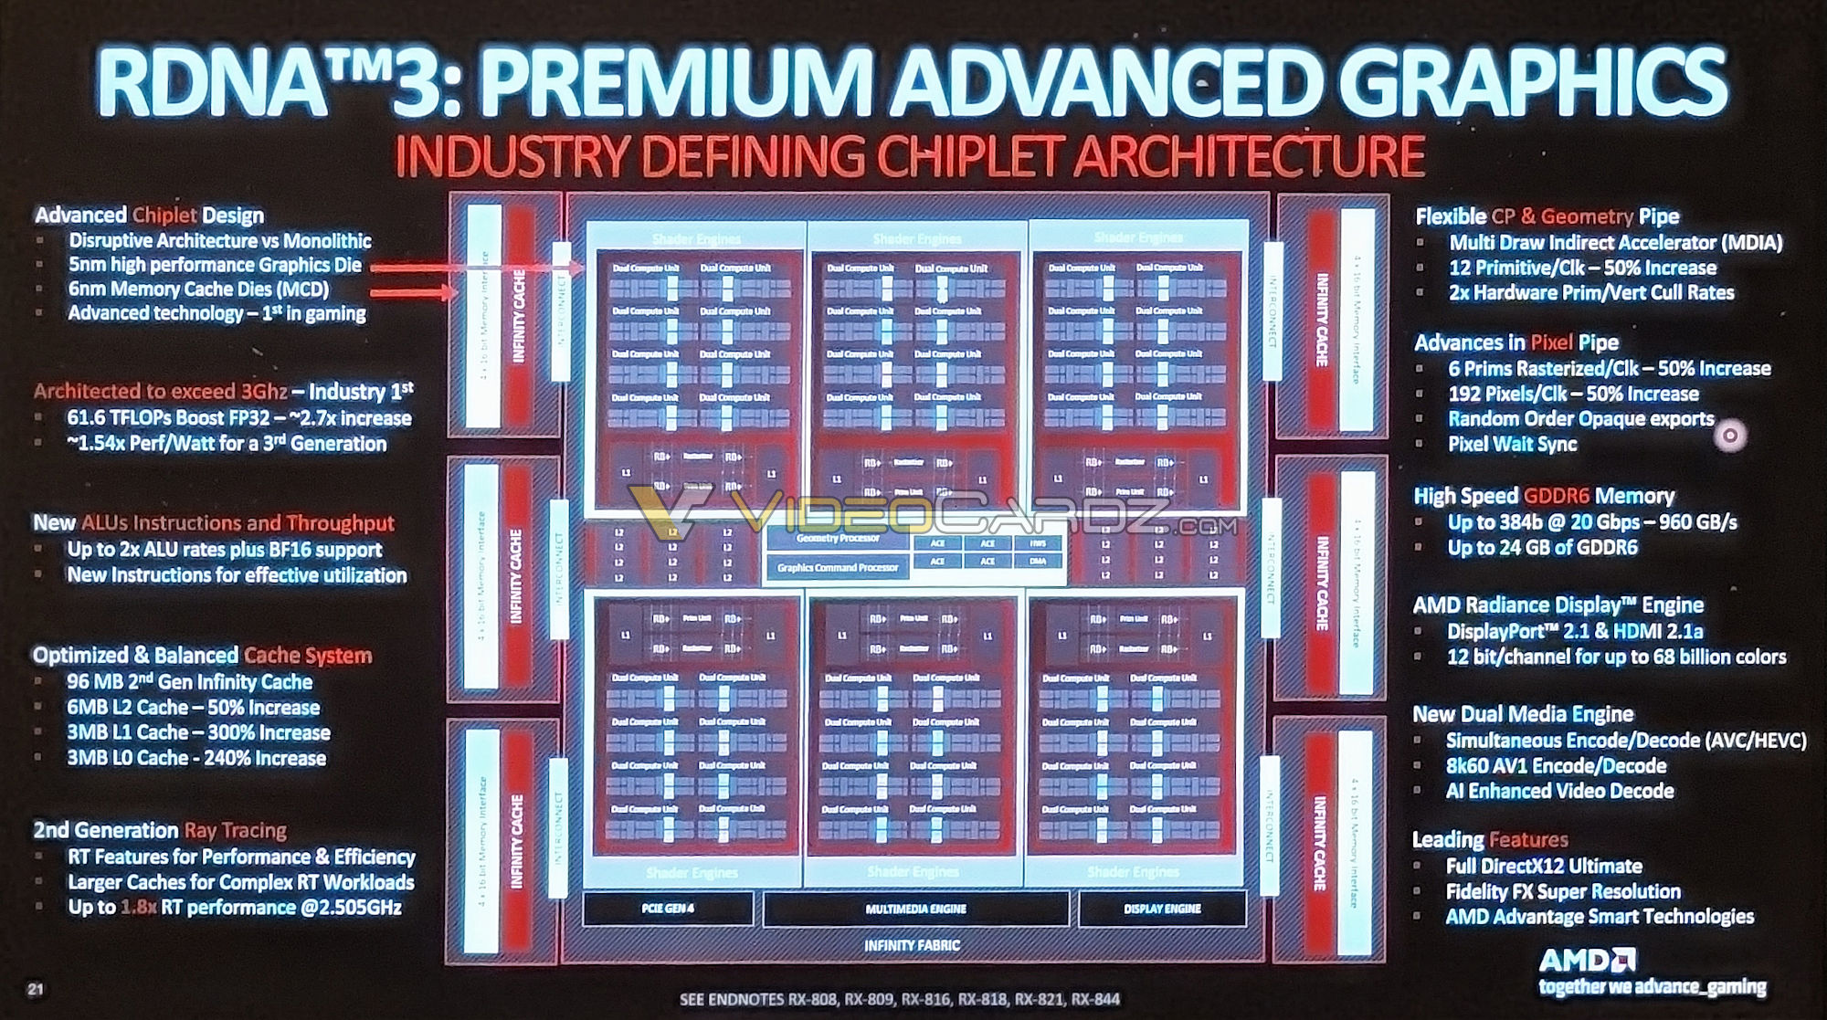

Slide 16
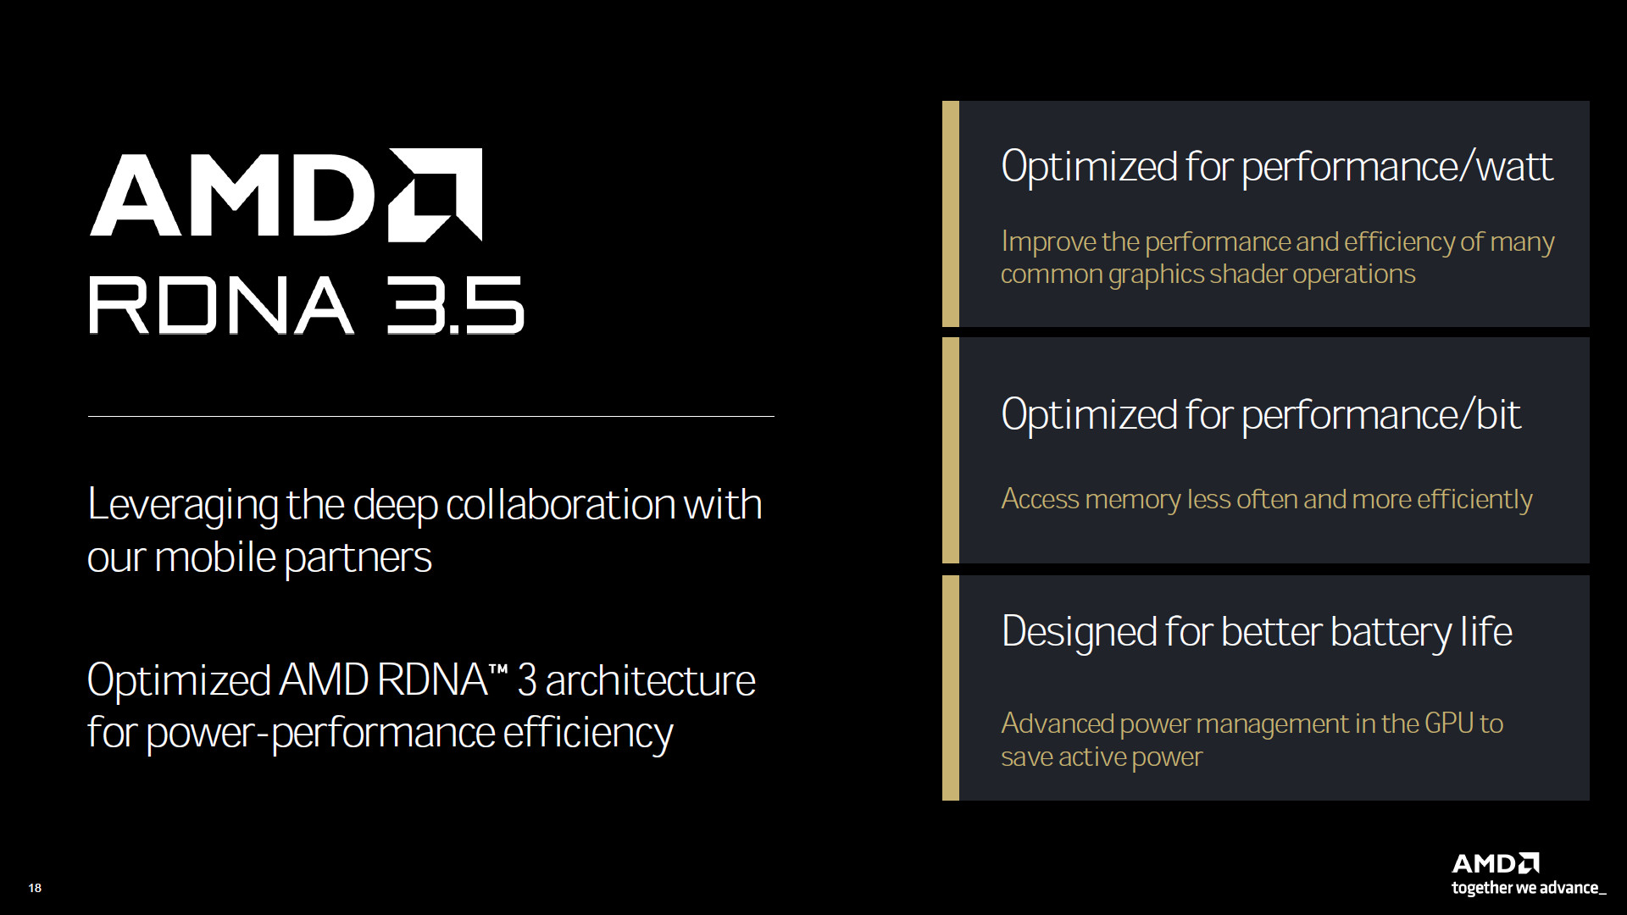

Slide 17
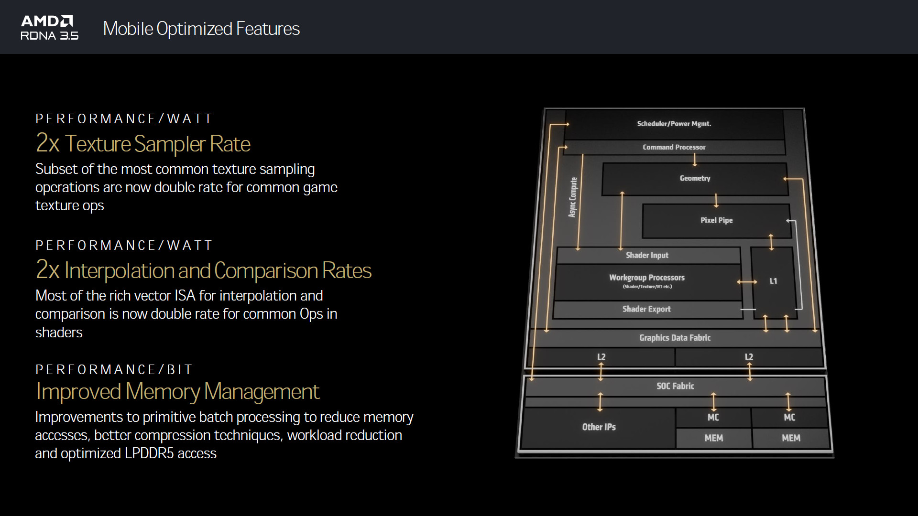

Slide 18
XDNA
XDNA 2

Slide 19
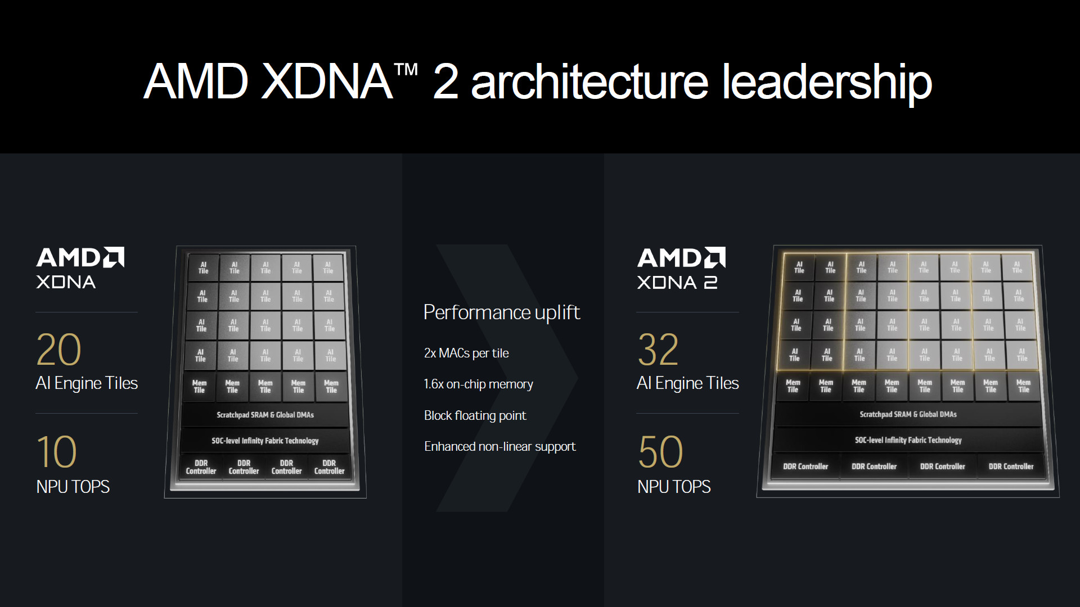

Slide 20
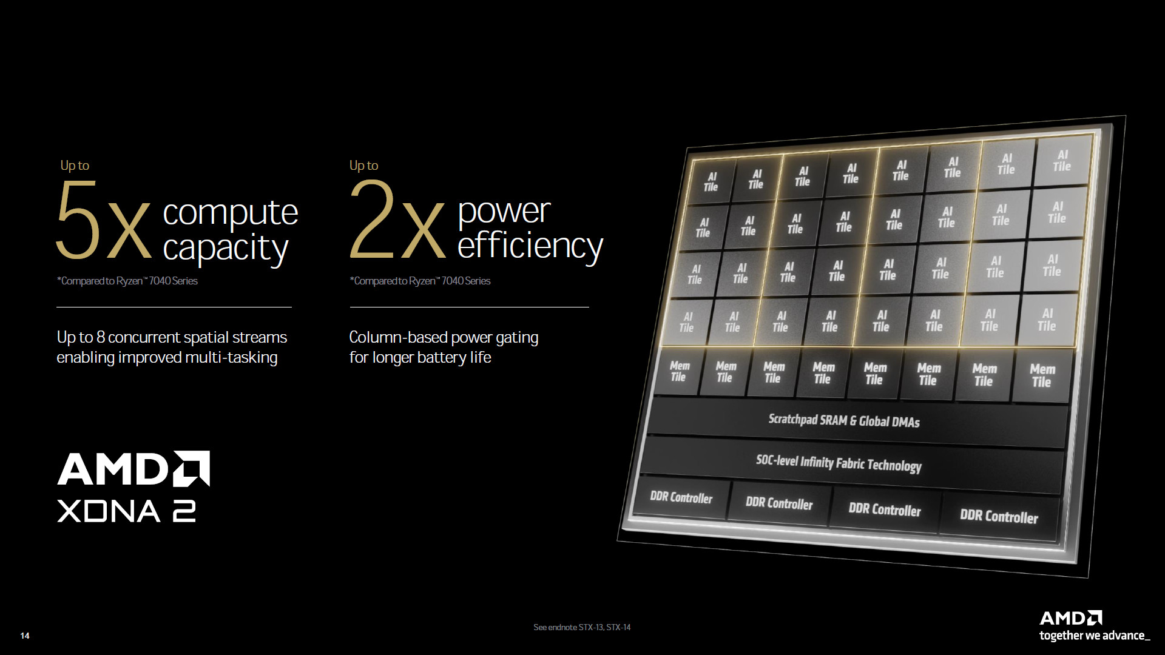

Slide 21
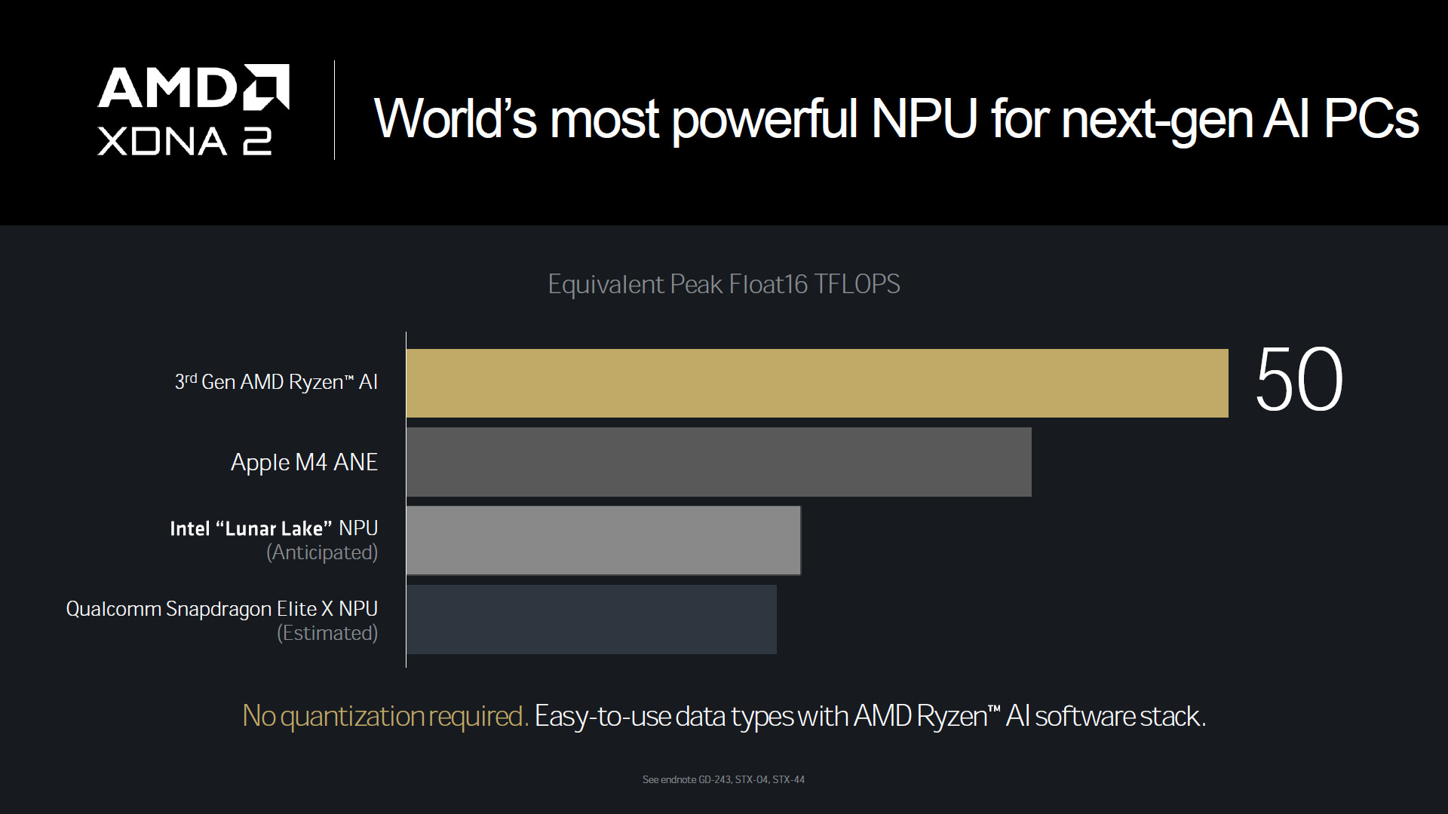

Slide 22
Unified Memory Architecture
统一内存架构

Slide 23
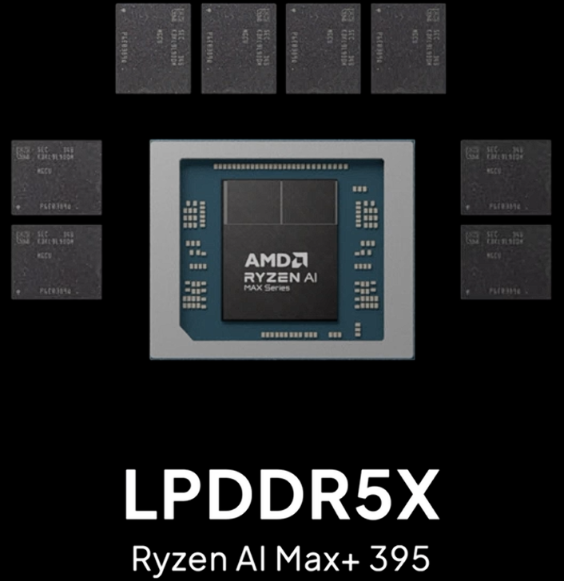
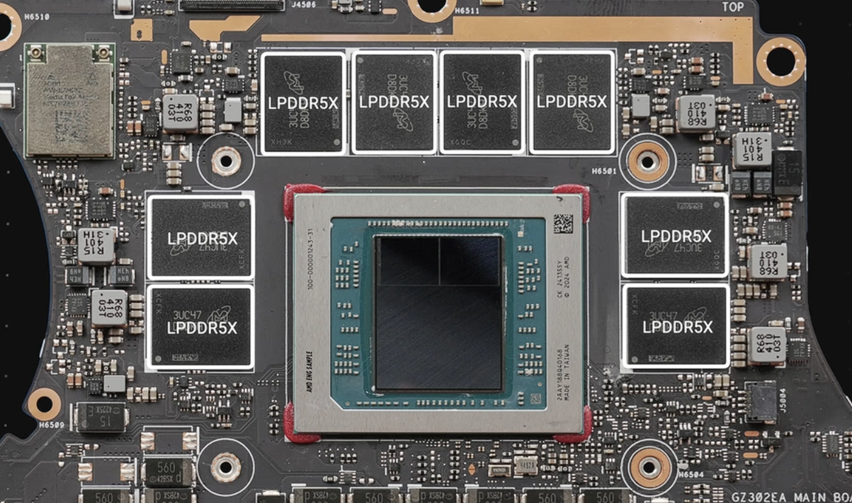
介绍

Slide 24
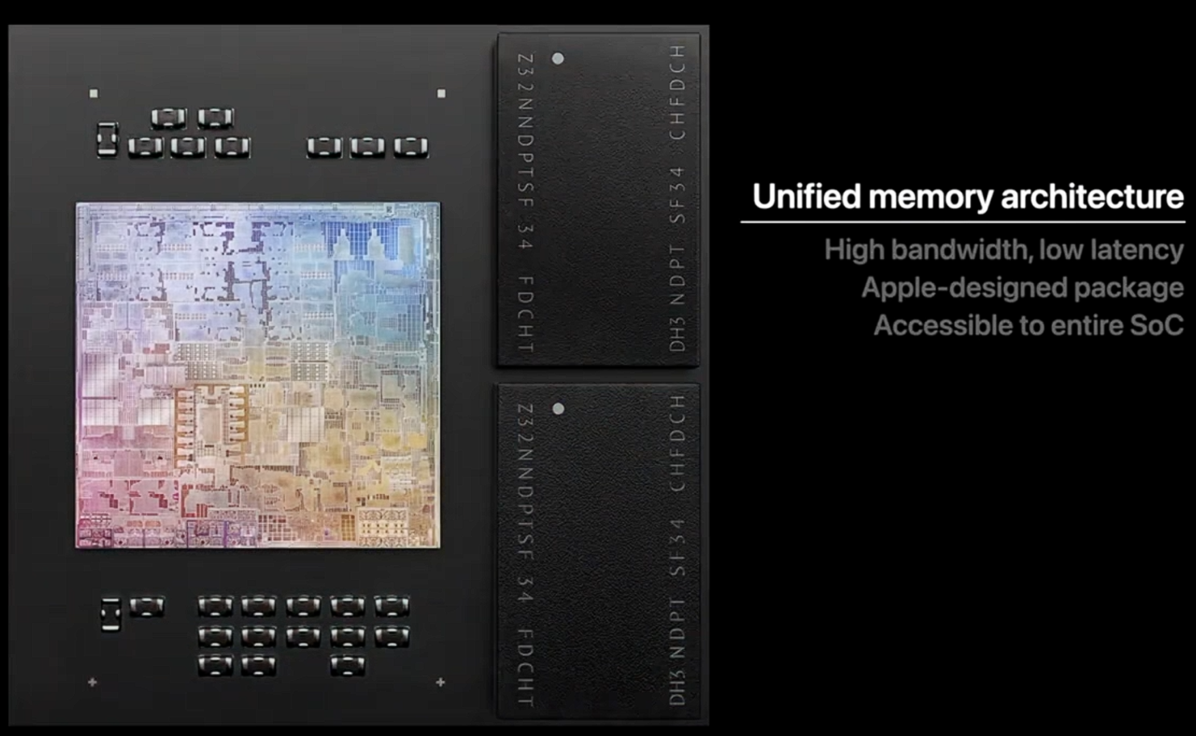
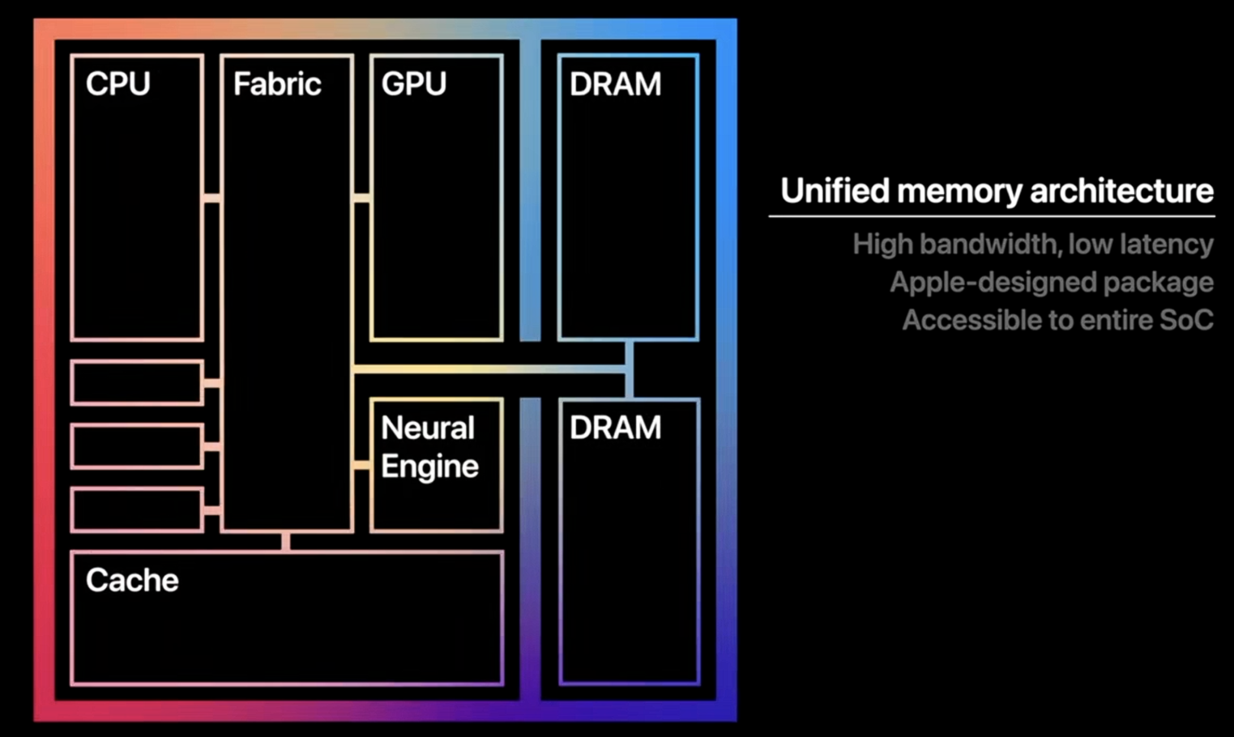
隔壁棚的设计
GPU可以直接访问内存
内存＝显存，显存 = 内存

Slide 25


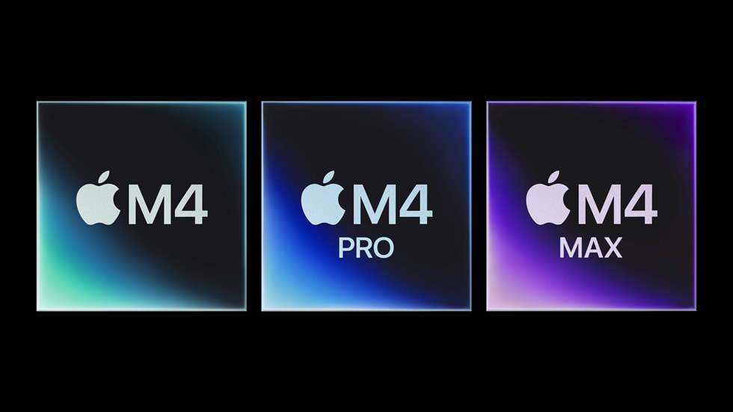

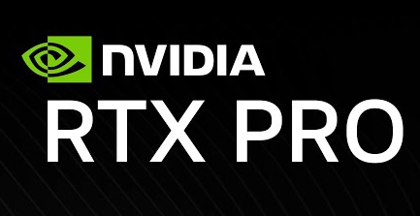
LLM 本地推理模拟跑分
本地小模型
*并非实际数据，仅作为示例展示！并非实际数据，仅作为示例展示！
*Token/s越高越厉害
Radeon 8060s
96GB
60 Token/s
XXX 品牌 laptop
NT$69,999起
Apple M4 Pro
96GB
60 Token/s
Mac Mini x4
NT$188,000起
RTX 5090
32GB
190 Token/s
High-End PC
NT$100,000起
RTX PRO 6000
Workstations
96GB
200 Token/s
NT$329,000起
RTX 5060 Ti
16GB
60 Token/s
Mid-End PC
NT$18,900起
0 Token/s
40 Token/s
80 Token/s
120 Token/s
160 Token/s
200 Token/s
并非实际数据，仅作为示例展示！

Slide 26
LLM 本地推理模拟跑分
本地大模型
*并非实际数据，仅作为示例展示！并非实际数据，仅作为示例展示！
*Token/s越高越厉害
Radeon 8060s
96GB
15 Token/s
XXX 品牌 laptop
NT$69,999起
Apple M4 Pro
96GB
15 Token/s
Mac Mini x4
NT$188,000起
RTX 5090
32GB
0 Token/s 爆显存！模型载入不能
High-End PC
NT$100,000起
RTX PRO 6000
Workstations
96GB
50 Token/s
NT$329,000起
RTX 5060 Ti
0 Token/s 爆显存！模型载入不能
16GB
Mid-End PC
NT$18,900起
0 Token/s
10 Token/s
20 Token/s
30 Token/s
40 Token/s
50 Token/s
并非实际数据，仅作为示例展示！

Slide 27
跑分
电子斗蛐蛐

Slide 28


3D Mark Timespy
GPU在DX12 图形API分辨率为2K下的理论跑分
*以TDP为80W的 “Radeon 8060” 为基准。
*分数越高越好。
Radeon 8060s
9882
RDNA 3.5
80W
100%
Radeon 8060s
2526
15W
25.56%
RDNA 3.5
Radeon 780M
2787
15W
28.20%
RDNA 3
Radeon 890M
3333
RDNA 3.5
15W
33.77%
RTX 3060 Laptop
8278
Ampere
115W
83.77%
RTX 4060 Laptop
10404
Ada Lovelace
115W
105.28%
RTX 5060 Laptop
12040
Blackwell
115W
121.84%
Arc 140T Mobile
3787
Xe-LPG+
35W
38.32%
0%
100%
120%

Slide 29




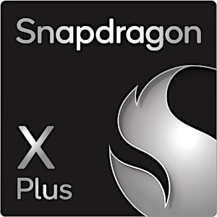
Cinebench R23
Multi Core多核分数
*N3B为TSMC第一代3nm技术节点，N3E为TSMC第二代3nm技术节点，N3P为TSMC第三代3nm技术节点。
*Ryzen AI Max+ 395为基准。
*分数越高越好。
Ryzen AI Max+ 395
33960
120W
100%
Zen5
TSMC N4P(4nm)
Ryzen 9 9955HX3D
38400
101W
113.07%
Zen5
TSMC N4P(4nm)
Core Ultra 9 285HX
38963
Lion Cove(P-cores) Skymont(E-cores)
160W
114.73%
TSMC N3B(3nm)
Core I9 14900HX
33619
Raptor Cove(P-cores) Gracemont(E-cores)
157W
98.99%
Intel7(10nm)
Apple M4 (10-core)
13471
40W
39.67%
Donan(P-cores) Brave(E-cores)
TSMC N3E(3nm)
Apple M4 Pro
23105
46W
68.04%
Donan(P-cores) Brave(E-cores)
TSMC N3E(3nm)
Apple M4 Max
27399
70W
80.68%
Donan(P-cores) Brave(E-cores)
TSMC N3E(3nm)
Qualcomm Snapdragon X2 Elite Extreme (X2E-96-100)
24082
96W
70.91%
3rd Gen QualcommOryon CPU
TSMC N3P(3nm)
0%
100%
120%

Slide 30
Cinebench R23
Single Core单核分数
*N3B为TSMC第一代3nm技术节点，N3E为TSMC第二代3nm技术节点，N3P为TSMC第三代3nm技术节点。
*Ryzen AI Max+ 395为基准。
*分数越高越好。
Ryzen AI Max+ 395
2034
120W
100%
Zen5
TSMC N4P(4nm)
Ryzen 9 9955HX3D
2166
101W
106.49%
Zen5
TSMC N4P(4nm)
Core Ultra 9 285HX
2244
Lion Cove(P-cores) Skymont(E-cores)
160W
110.32%
TSMC N3B(3nm)
Core I9 14900HX
2183
Raptor Cove(P-cores) Gracemont(E-cores)
157W
107.33%
Intel7(10nm)
Apple M4 (10-core)
2159
40W
106.15%
Donan(P-cores) Brave(E-cores)
TSMC N3E(3nm)
Apple M4 Pro
2276
46W
111.90%
Donan(P-cores) Brave(E-cores)
TSMC N3E(3nm)
Apple M4 Max
2281
70W
112.14%
Donan(P-cores) Brave(E-cores)
TSMC N3E(3nm)
Qualcomm Snapdragon X2 Elite Extreme (X2E-96-100)
2020
96W
99.31%
3rd Gen QualcommOryon CPU
TSMC N3P(3nm)
0%
100%
120%

Slide 31
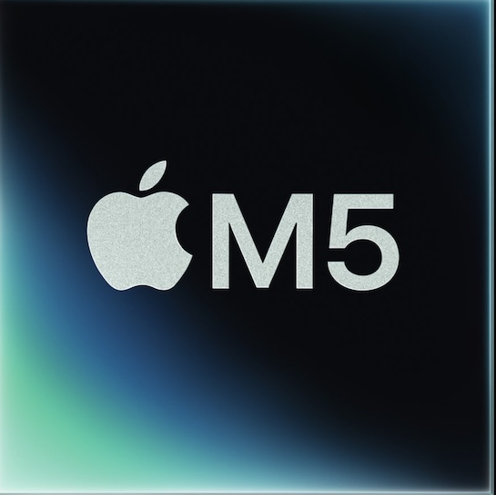
Cinebench R23
Single Core单核分数
*N3B为TSMC第一代3nm技术节点，N3E为TSMC第二代3nm技术节点，N3P为TSMC第三代3nm技术节点。
*Ryzen AI Max+ 395为基准。
*分数越高越好。
Ryzen AI Max+ 395
2034
120W
100%
Zen5
TSMC N4P(4nm)
Ryzen 9 9955HX3D
2166
101W
106.49%
Zen5
TSMC N4P(4nm)
Core Ultra 9 285HX
2244
Lion Cove(P-cores) Skymont(E-cores)
160W
110.32%
TSMC N3B(3nm)
Core I9 14900HX
2183
Raptor Cove(P-cores) Gracemont(E-cores)
157W
107.33%
Intel7(10nm)
Apple M4 (10-core)
2159
40W
106.15%
Donan(P-cores) Brave(E-cores)
TSMC N3E(3nm)
Apple M4 Pro
2276
46W
111.90%
Donan(P-cores) Brave(E-cores)
TSMC N3E(3nm)
Apple M4 Max
2281
70W
112.14%
Donan(P-cores) Brave(E-cores)
TSMC N3E(3nm)
Qualcomm Snapdragon X2 Elite Extreme (X2E-96-100)
2020
96W
99.31%
3rd Gen QualcommOryon CPU
TSMC N3P(3nm)
Apple M5 (10-core)
2569
70W
126.30%
Donan(P-cores) Brave(E-cores)
TSMC N3P(3nm)
0%
100%
120%

Slide 32
总结

Slide 33
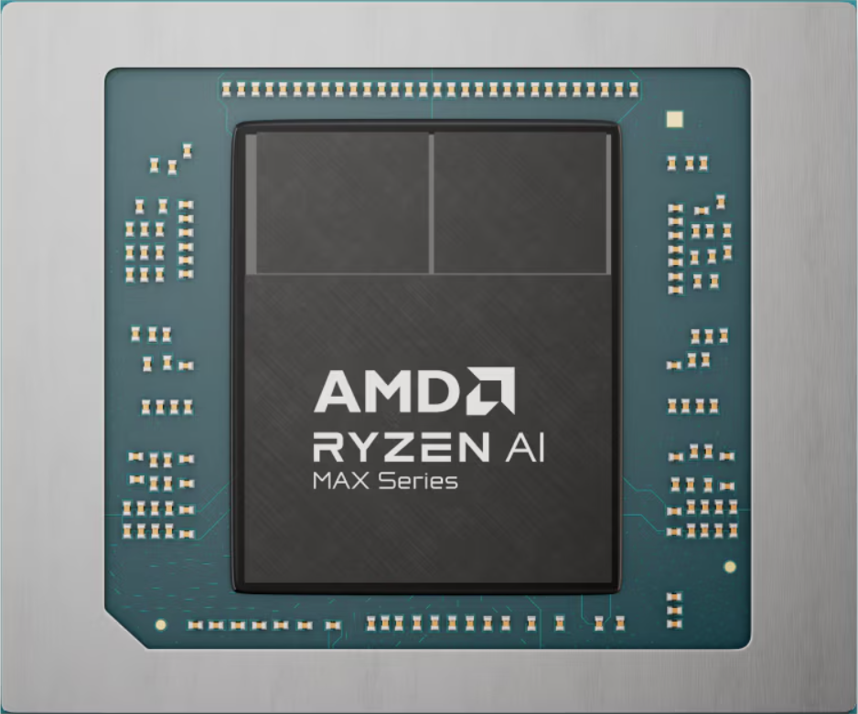
16x
Zen5 CPU
TSMC
N4P
Unified Memory Architecture
50 TOPS
NPU
LPDDR5X-8000
Up to 128GB
126 TOPS
Overall
Radeon 8060S
RDNA3.5
PBO
Ryzen
AI
40
CUs
2560
Shading unit
PCIE 4.0
configurable TDP
Start from only NT$69999 ~ NT$84999

